Slide 1
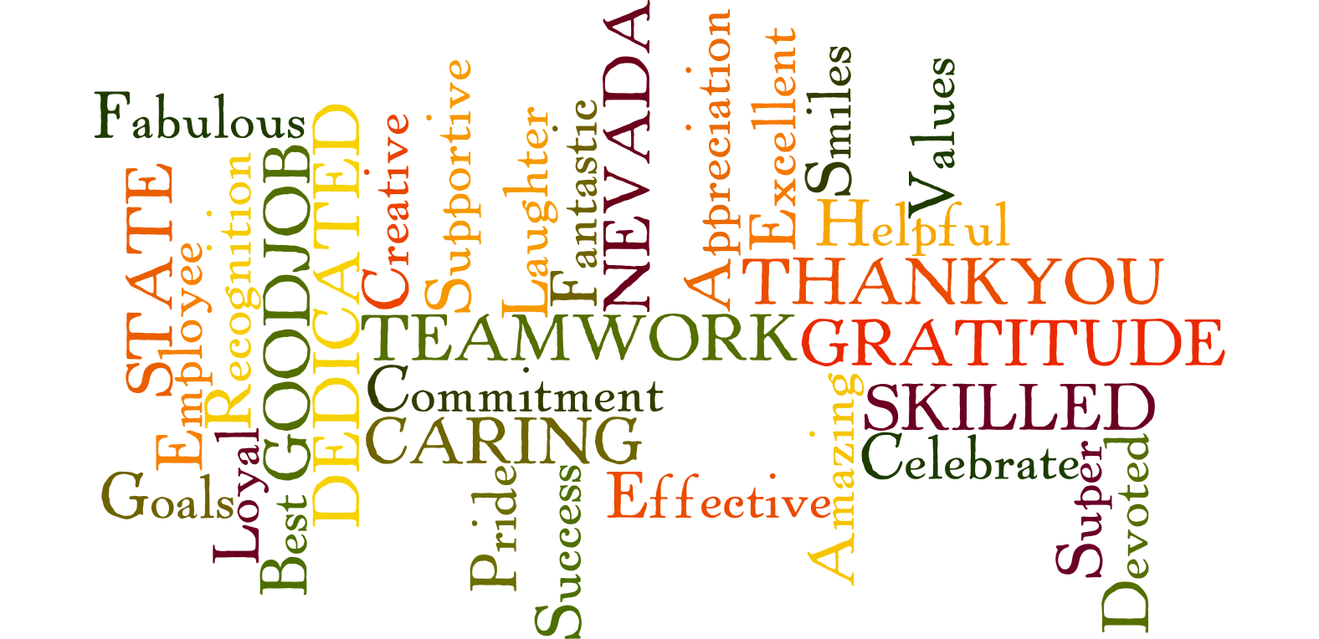
Nevada State Employee Appreciation Week
May 4th – May10th, 2025

Slide 2

Nevada State Employee Appreciation Week
May 4th – May 10th, 2025

Slide 3

Nevada State Employee Appreciation Week
May 4th – May 10th 2025

Slide 4

Nevada State Employee Appreciation Week
May 4th – May 10th, 2025

Slide 5

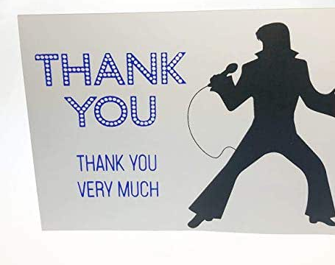
Nevada State Employee Appreciation Week
May 4th – May 10th, 2025

Slide 6


Nevada State Employee Appreciation Week
May 4th – May 10^{th,} 2025

Slide 7

Nevada State Employee Appreciation Week
May 4th – May 10^{th,} 2025

Slide 8

Nevada State Employee Appreciation Week
May 4th – May 10th, 2025

Slide 9

Nevada State Employee Appreciation Week
May 4th – May 10th, 2025

Slide 10

Nevada State Employee Appreciation Week
May 4th – May 10th, 2025

Slide 11

Nevada State Employee Appreciation Week
May 4th – May 10th, 2025

Slide 12

Nevada State Employee Appreciation Week
May 4th – May 10th, 2025

Slide 13

Nevada State Employee Appreciation Week!
May 4th – May 10th, 2025

Slide 14

Nevada State Employee Appreciation Week
May 4th through May 10th, 2025

Slide 15

Nevada State Employee Appreciation Week
May 4th through May 10th, 2025

Slide 16

Nevada State Employee Appreciation Week
May 4th through May 10th, 2025

Slide 17
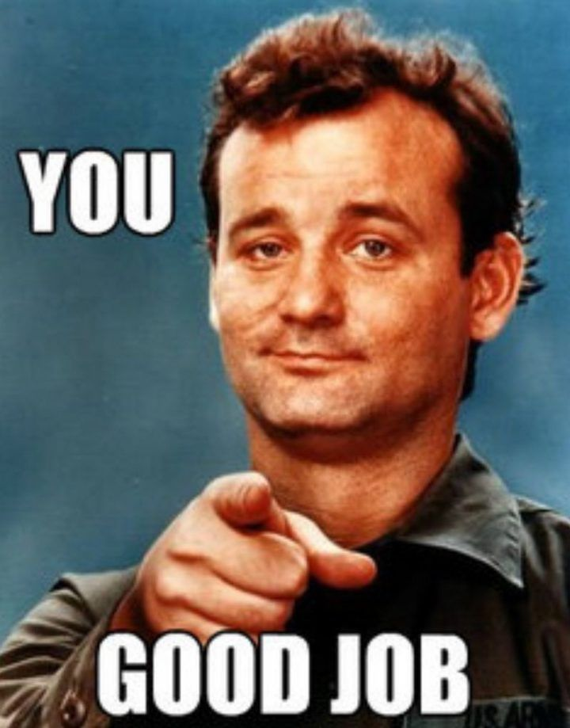
Nevada State Employee Appreciation Week
May 4th through May 10th, 2025

